Slide 1

Google Trends
Deepak Kumar
MCA Corporate

Slide 2

Objective
To analyze and visualize Google Trends data in the IT sector using Power BI and a data fetch API, delivering actionable insights into industry trends, emerging technologies, and regional interest patterns.

Slide 3


Scope
Data Source: Google Trends API.
Key Metrics: Search volume trends, regional interest, technology popularity, and temporal patterns.
Target Audience: IT professionals, analysts, and decision-makers.

Slide 4
Deliverables
Interactive Power BI dashboards.
Visualizations of search trends by region and timeframe.
Insights into emerging technologies and tools within the IT sector.

Slide 5
Tools & Technologies
Data Fetch:
Google Trends API.
Data Analysis & Visualization:
Power BI.
Data Processing:
Python/SQL (if required for preprocessing).

Slide 6
Milestones
Set up API integration and fetch relevant Google Trends data.
Clean and preprocess data for analysis.
Develop Power BI dashboards.
Validate insights with stakeholders.

Slide 7
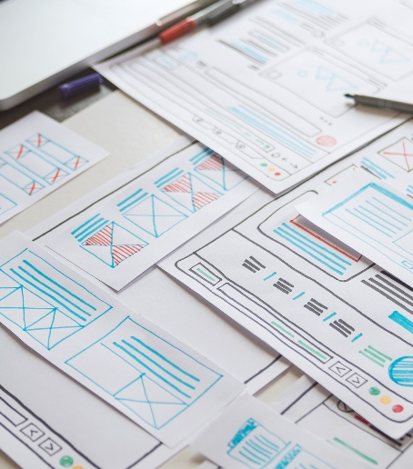
Outcome
A comprehensive and interactive dashboard that provides a clear understanding of IT sector trends, supporting data-driven decision-making.
If you need any assistance with any of these steps, feel free to ask! I can help you with coding in Python/SQL, setting up the Google Trends API, or creating visualizations in Power BI.

Slide 8


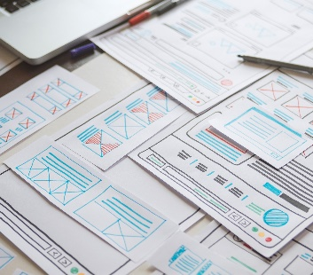



Thank you
Deepak Kumar
deepakkumar2.mcac2024@ritroorkee.com
www.linkedin.com/in/deepak-kumar-635bb8324

